Slide 1
See my Facebook Page:
https://www.facebook.com/photo/?fbid=3051668768466431&set=a.1442296016070389
Using AD, AB, BE, ME
AD, BC, CE, BCE, BP,
AD : Anno Domini
AB : Anno Buddhae (Year of Religion)
BE : Buddhist Era (Year of Religion)
BE : Burmese Era (Old Use) (မြန်မာသက္ကရာဇ်)
ME : Maha Era
ME : Myanmar Era (Recent Use) (1388 ME now)

Slide 2
AD : Anno Domini (ခရစ်နှစ်)
BC : Before Christ (ခရစ်တော်မပေါ်မီနှစ်)
SE : Sasana Sakarit (သာသနာနှစ်) (Year of Religion) 2570 SE
AB : Anno Buddhae (သာသနာနှစ်) (Sasana Sakarit/ Year of Religion) 2570 AB
BE : Buddhist Era (သာသနာနှစ်) (Sasana Sakarit/ Year of Religion) 2570 BE
BE : Burmese Era (မြန်မာသက္ကရာဇ်) (Koza Sakarit) (Old Use) 1388 BE
ME : Māha Era (မဟာသက္ကရာဇ်)
ME : Myanmar Era (မြန်မာသက္ကရာဇ်) (Koza Sakarit)(Recent Use) (1388 ME) Now
THE
BUDDHIST
ERA

Slide 3
Maha Sakarit / Maha Era and Buddhist Era are the same? Sir
Maha Sakarit / Maha Era is before the Parinibbāna.
Buddhist Era is after Parinibbāna. It is also call Sasana Sakkarāj (or) Year of Religion (or) Anno Buddhae (AB).
For instance: “In 1601, Anno Buddhae, and 419 Sakkarāj, King Anuruddha, the Lord of Arimaddanapura, brought a community of priests together with the Tipitaka (from Rāmaññadesa), and established the Religion in Arimaddanapura, otherwise called Pugāma (Bagan).”
Ref: “Kalyānī Inscriptions erected by King Dhammacetī at Pegu in 1476 AD” Text and Translation by Taw Sein Ko, 1892, p-49.

Slide 4
Besides in the articles and research papers of former prominent scholars and historians were used Anno Buddhae (AB) (or) Sāsanā Sakkarāj (or) Year of Religion.

Slide 5
- The former name of our country is Burma.
Now renamed as Myanmar.
BE (Burmese Era) is old use for abbreviation. Now use as Myanmar Era (ME) (or) Myanmar Sakarit (or) Kozā Sakarit
This year is 1388 ME.
But other Theravada countries are using these abbreviations BE (Buddhist Era) and ME (Maha Sakarit). Only our country is complicating for these terms BE (Buddhist Era, Burmese Era), ME (Maha Era, Myanmar Era).

Slide 6
Other Theravāda countries and international Buddhist literature use ME for Mahā Era and BE for Buddhist Era.
However, in Myanmar, BE can mean both "Buddhist Era" and "Burmese Era," and ME can mean both "Mahā Era" and "Myanmar Era."
So, we should not use abbreviation as BE for Buddhist Era and ME for Maha Sakarit. It will be confused for general readers.

Slide 7
AD: abbreviation for Anno Domini : a Latin phrase meaning
"in the year of the Lord", which is used when referring to a year after Jesus Christ was born.
BC: Before Christ
CE and BCE
CE stands for “common (or current) era”, while BCE stands for “before the common (or current) era”.

Slide 8
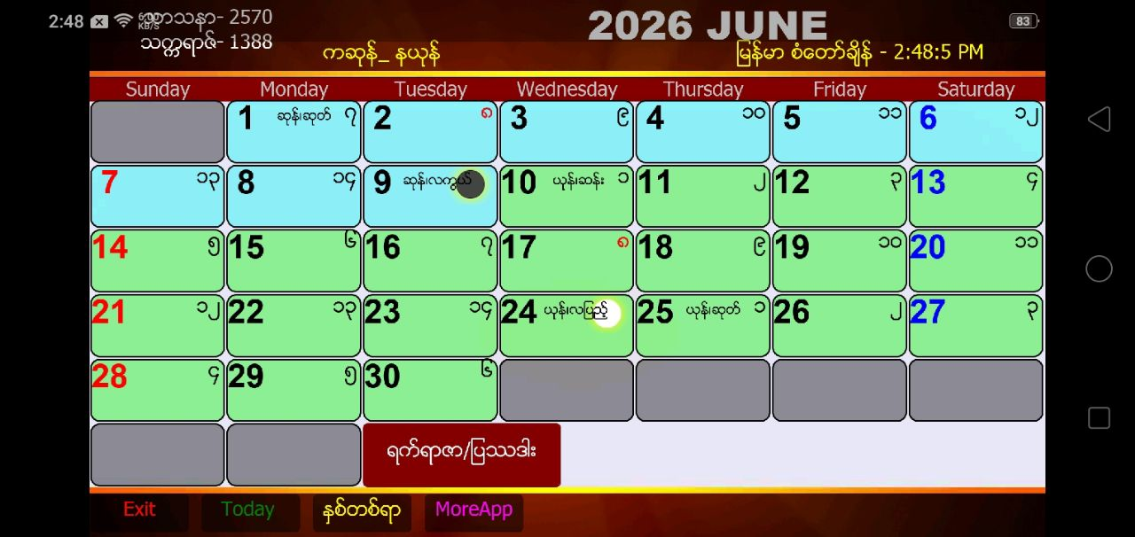
Buddhist Era – 2570
Myanmar Era - 1388
Now 2026 AD, 2570 BE, and 1388 ME
AD+544= BE (2026+544= 2570)
BE-544= AD (2570-544= 2026)
Convert from ME to AD (ME+638= AD) (1388+638=2026)
AD to ME (AD-638= ME) (2026-638= 1388)

Slide 9
BC+AD= BP (Years Before Present)
For instance: Myazedi stone inscription was dated 1112 AD or 474 Myanmar Era, whereas Rosetta stone inscription dated far back into B.C. 196.
BC 196 + 2023 AD = 2219 BP (Rosetta stone inscription)
Different time between Myazedi and Rosetta (1112+196= 1308)

Slide 10


Rare evidence of the use of Anno Domini (AD)
Judson, University of Yangon

Slide 11
ဗုဒ္ဓဘုရားရှင် ပရိနိဗ္ဗာန်ပြုတဲ့နှစ် ၅၄၄ ဘီစီ နှင့် ၄၈၃ ဘီစီ အယူအဆ မြန်မာသက္ကရာဇ်မှ ခရစ်နှစ် (AD) ကိုပြောင်းရာမှာ (+638) ထဲ့ပေါင်းရခြင်း
Concepts of 544 BC and 483 BC Regarding Buddha’s Parinibbana
When converting the Myanmar calendar year to the Gregorian calendar (AD), we add 638 years.
Silver Jubilee Magazine, ITBMU, December 2023
https://historicalteaching.com/concepts-of-544-bc-and-483-bc-regarding-buddhas-parinibbana/
https://historicalteaching.com/concepts-of-544-bc-and-483-bc-buddha-parinibbana-myanmar-text/

